Slide 1
Eye state detection using Random Forest
Riya Shipurkar

Slide 2
Dataset details
Kaggle dataset: https://www.kaggle.com/datasets/robikscube/eye-state-classification-eeg-dataset/data
1 – indicates eyes closed state
0 – indicates eyes open state
[rows, columns] – [14980, 15]

Slide 3
Project information
Aim: Build an ML model to accurately classify if a person’s eyes are open or close using the EEG dataset, using Random Forest classifier.
ML Concepts Explored
Understand the ML concept of Random Forest
Other concepts: Accuracy, Confusion Matrix, Prediction, Decision Trees, Training/Testing sets, Labels, Features, Random State

Slide 4
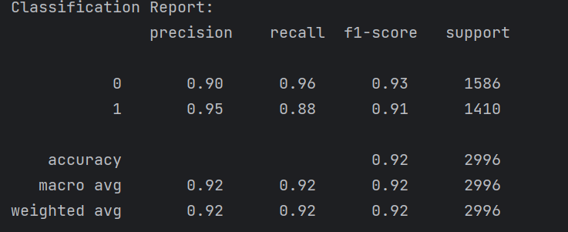
Classification Report

Slide 5
Classification Report
Precision = Correct Positive Predictions/All Positive Predictions
Recall = Correct Positive Predictions/ All actual positives
Predicted positive | Predicted negative
Positive | True positive | False Negative
Negative | False positive | True Negative
Precision = True Positive/ [True Positive + False Positive]
Recall = True Positive/ [True Positive + False Negative]

Slide 6
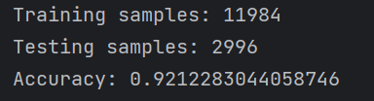
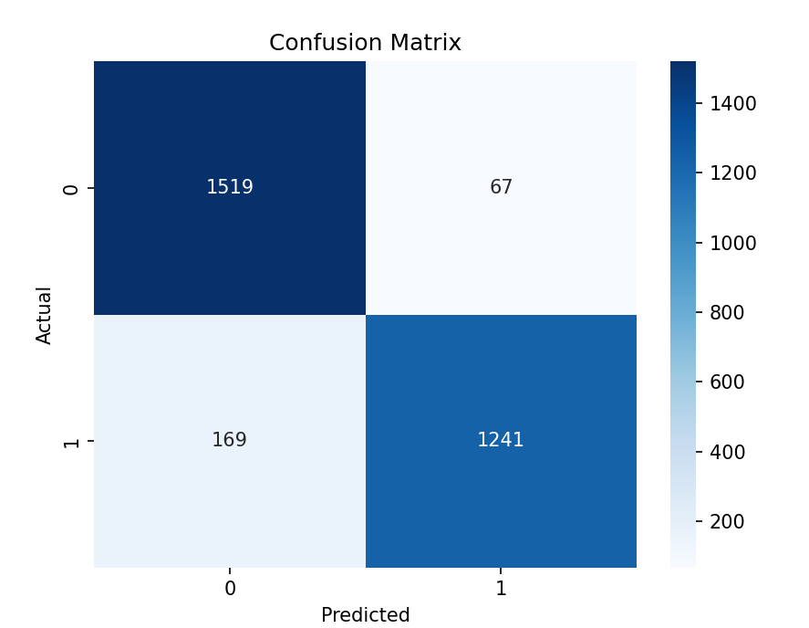
Confusion Matrix
1519 – True Negative
67 – False Positive
169 – False Negative
1241 – True Positive

